Slide 1
Speaker Modelling
ETLYAK
Notes:
Jonas

Slide 2
Description
Goals
Predict
Compare
Methods
Analogies
Matlab
Measurements
Notes:
Jonas

Slide 3


Analysis
Thiele/Small
Electrical, mechanical, acoustical
Transfer Functions
2. order HP
Drive Unit
Infinite enclosure
Cross-over filter
Bass reflex
Notes:
Jonas

Slide 4
Design
Matlab vs. Spice
Why Classes?
Class diagram
Notes:
Lasse

Slide 5
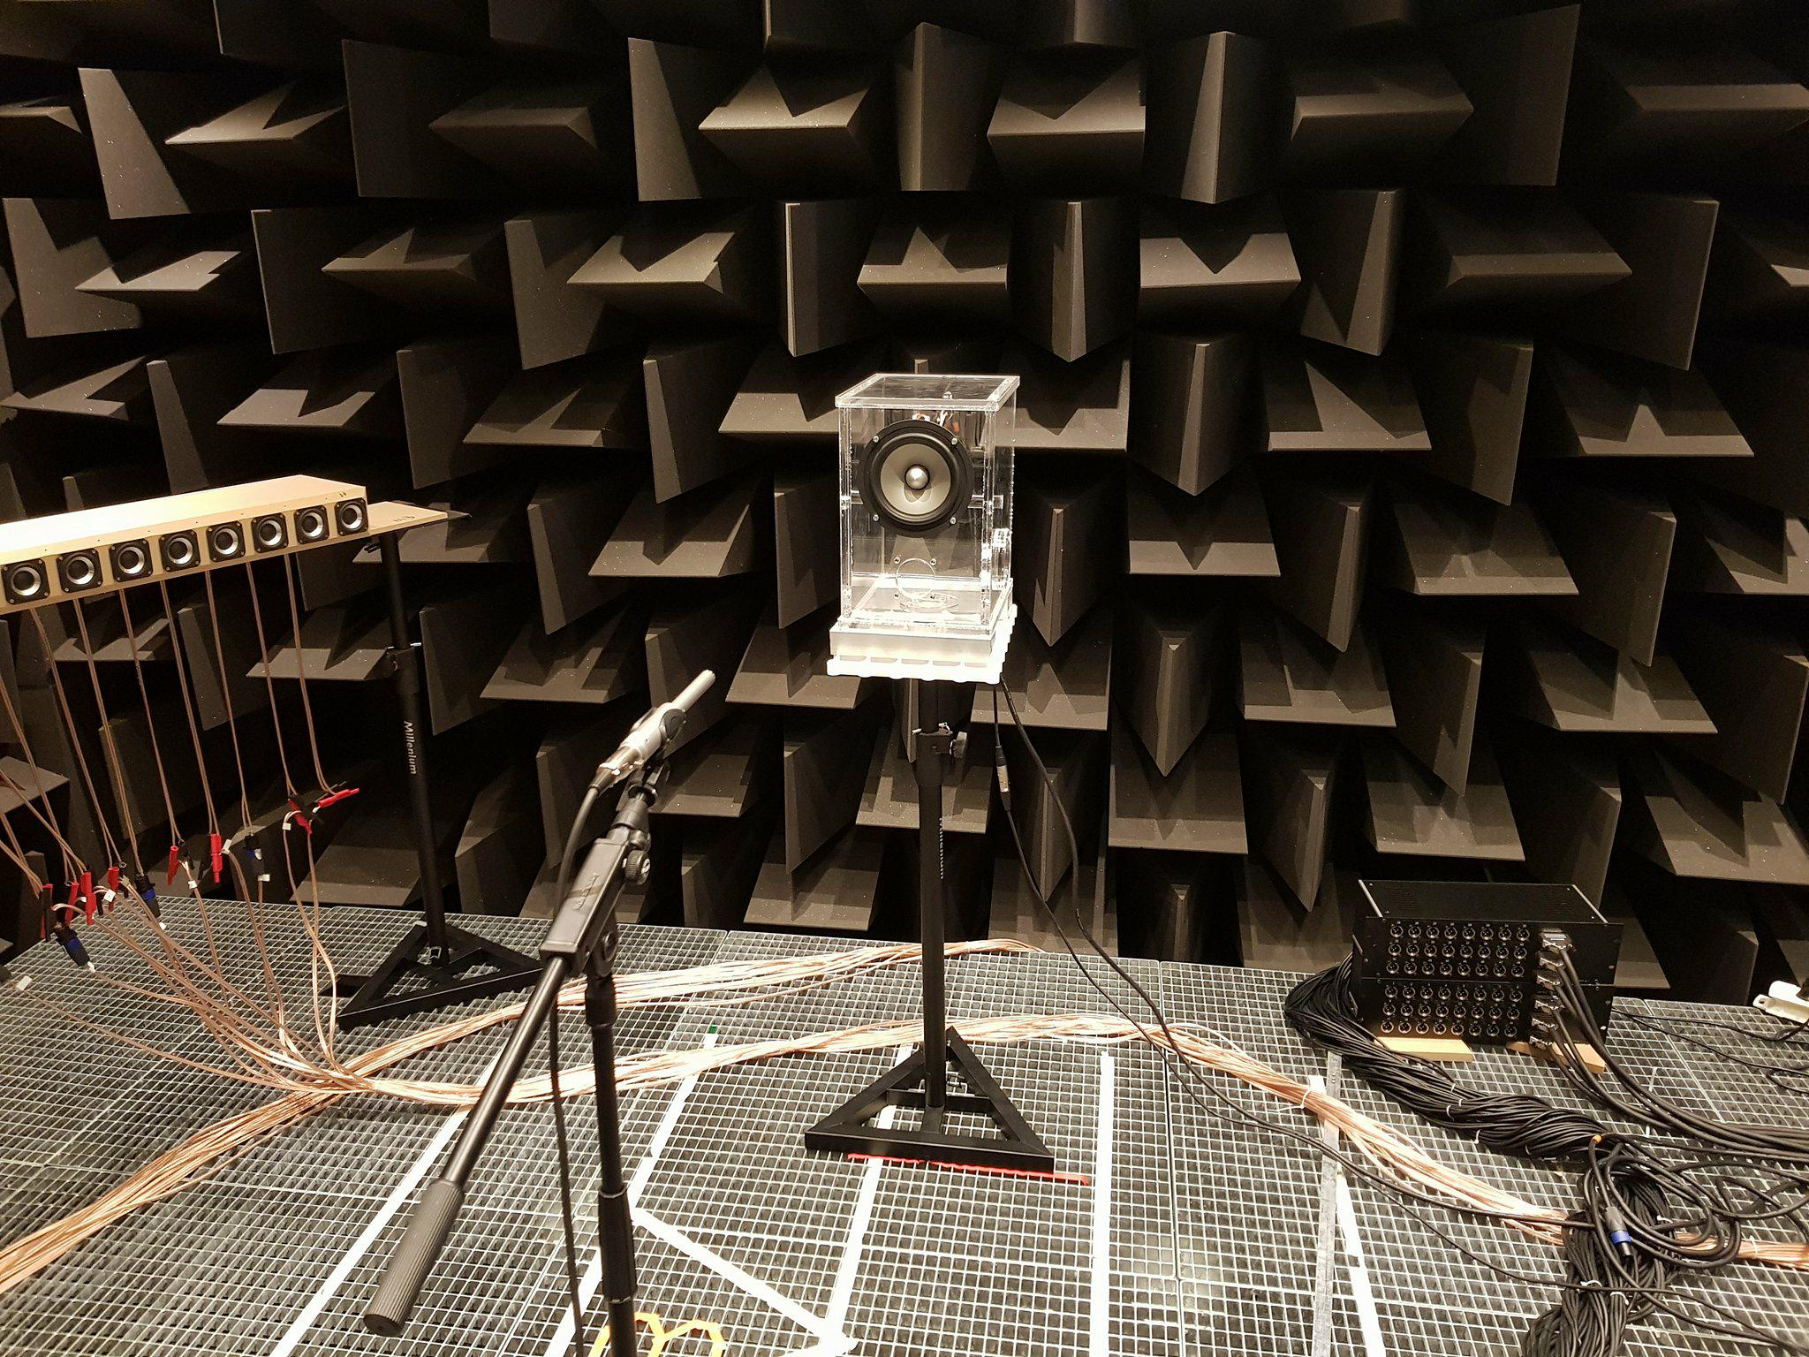
Measurement Setup
Equipment
Reflection on results
Notes:
Lasse

Slide 6
Results
Comparison of model and measurements
Notes:
Lasse

